Slide 1
Vista Lab 5 (lab 6)
Velocity Analysis
and migration

Slide 2
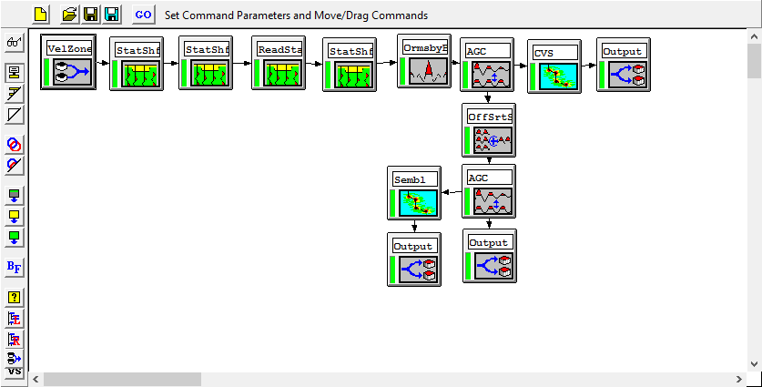
Part 1: Prepare for interactive velocity analysis
Processing flow to compute CMP gathers, semblance panels and Constant Velocity Stacks (CVS)
Must have from lab 4, or if not recalculate.
FK_filter needs a file with FK filter design

Slide 3
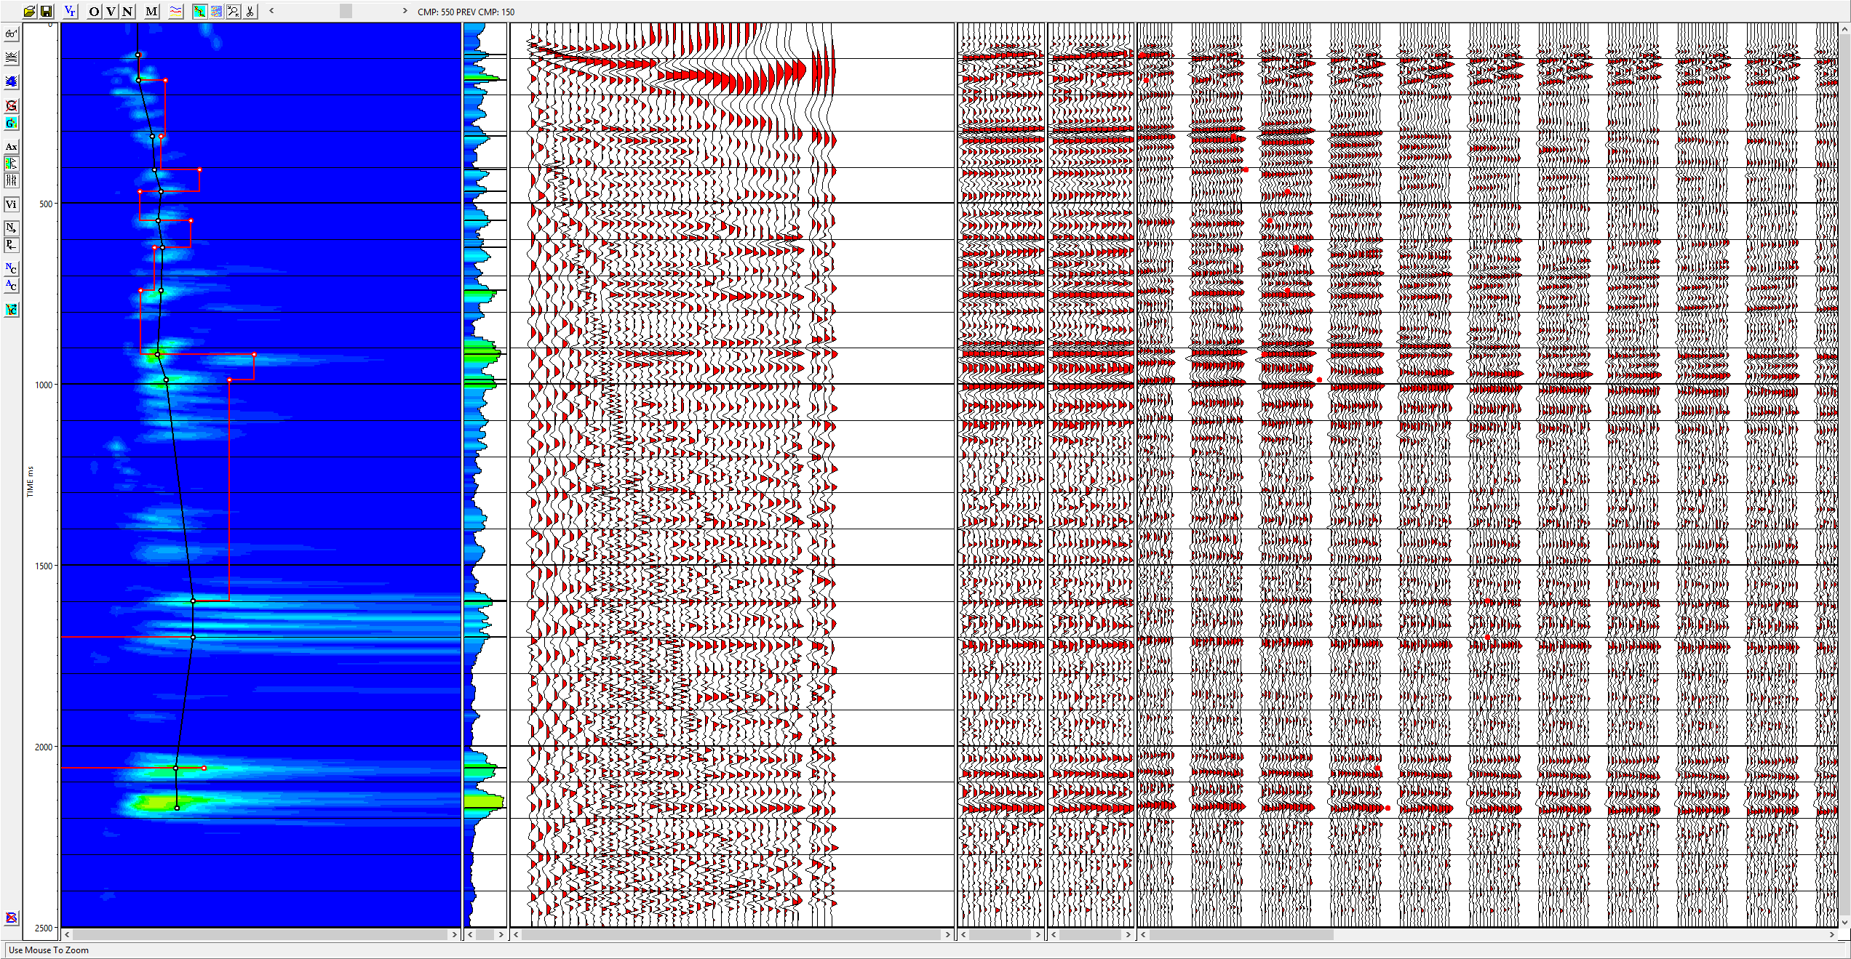
Part 2: Pick velocities
CMP gather with
fixed offset interval
Stacks with
new velocities
Constant Velocity Stacks
(cdp150:50:850)
Semblance

Slide 4
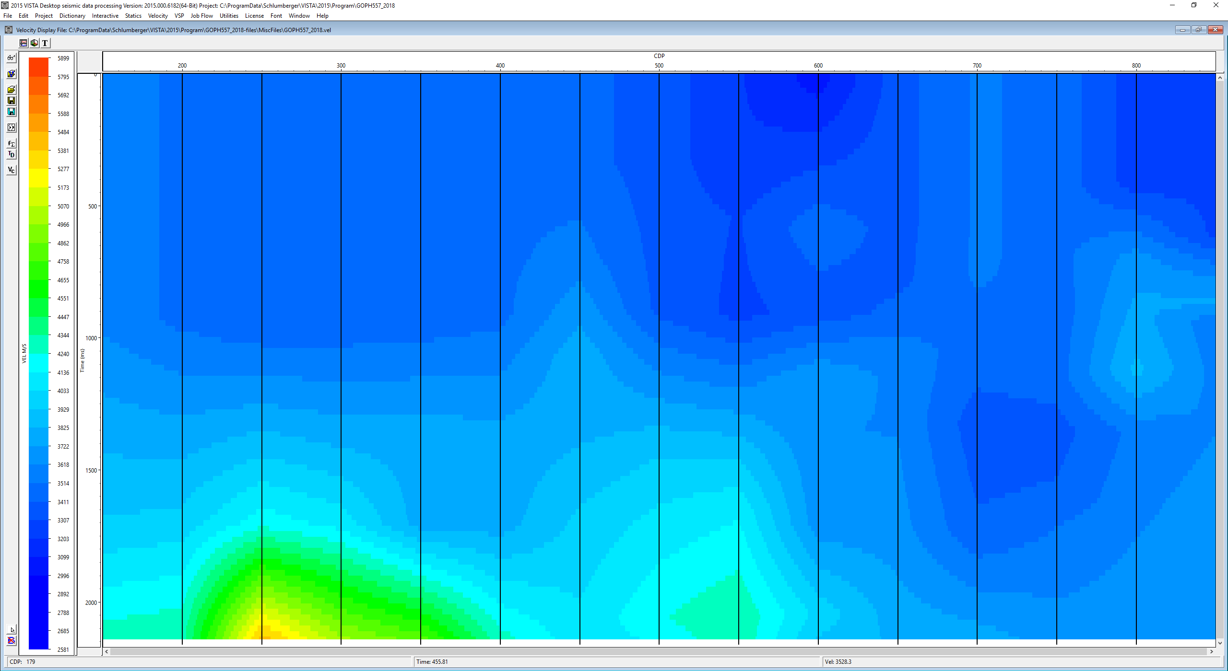
Picked Velocity

Slide 5
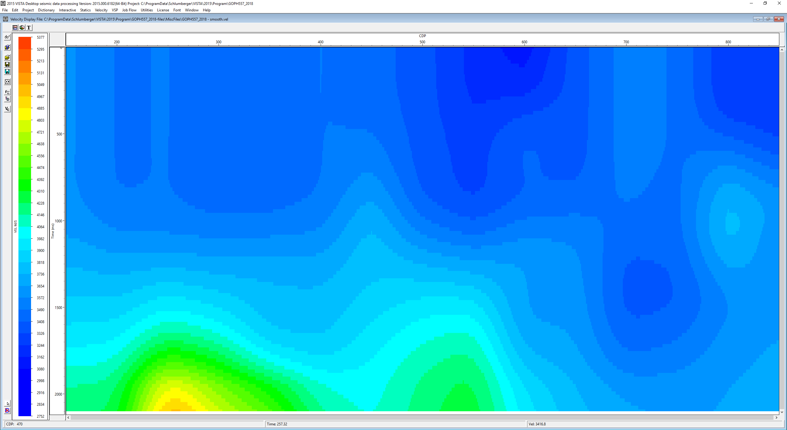
Picked Velocity after smoothing

Slide 6
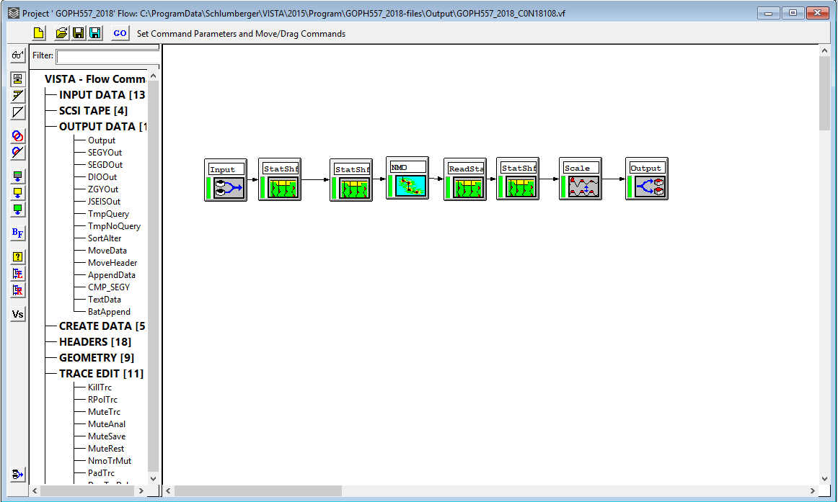
Part 3: Prepare for interactive velocity analysis
Create a flow to output NMO-corrected gathers
with old and new velocity

Slide 7
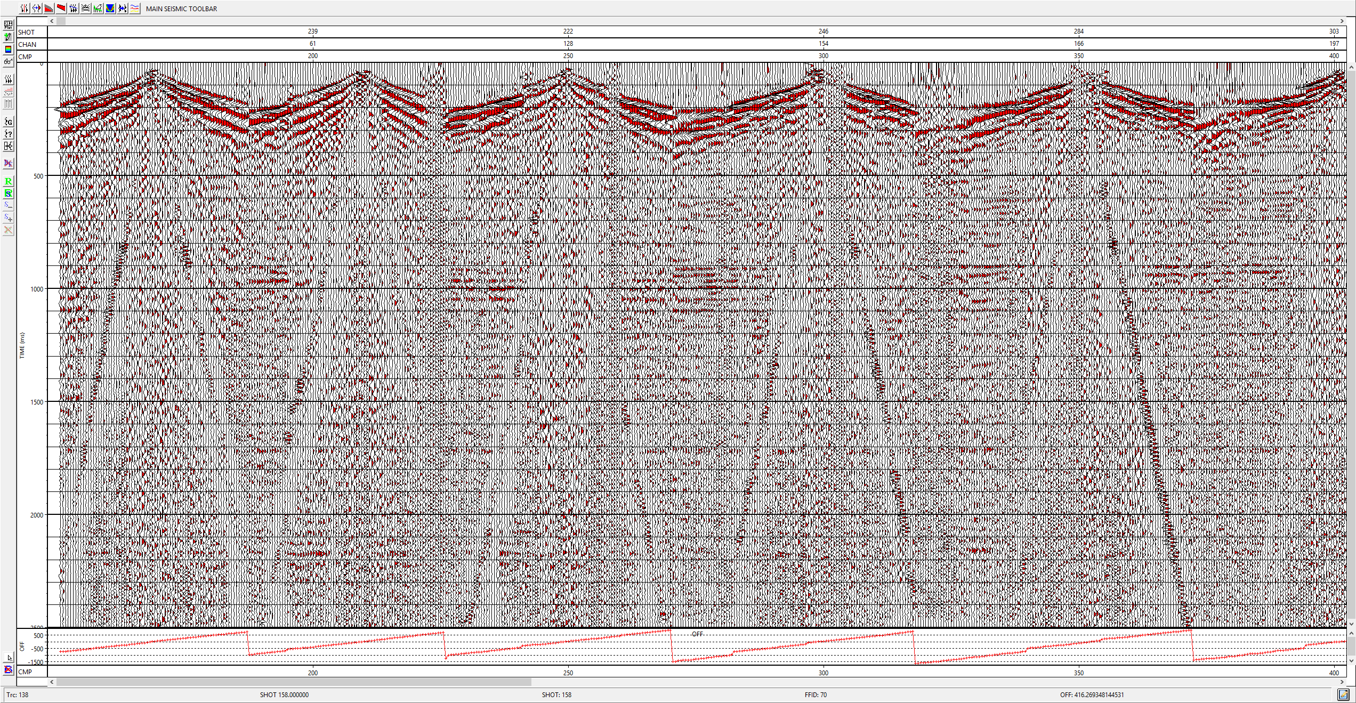
Part 4: Create a top mute file for FB and strecth
CMP 150
CMP 200
CMP gathers sorted by offset to pick mute

Slide 8
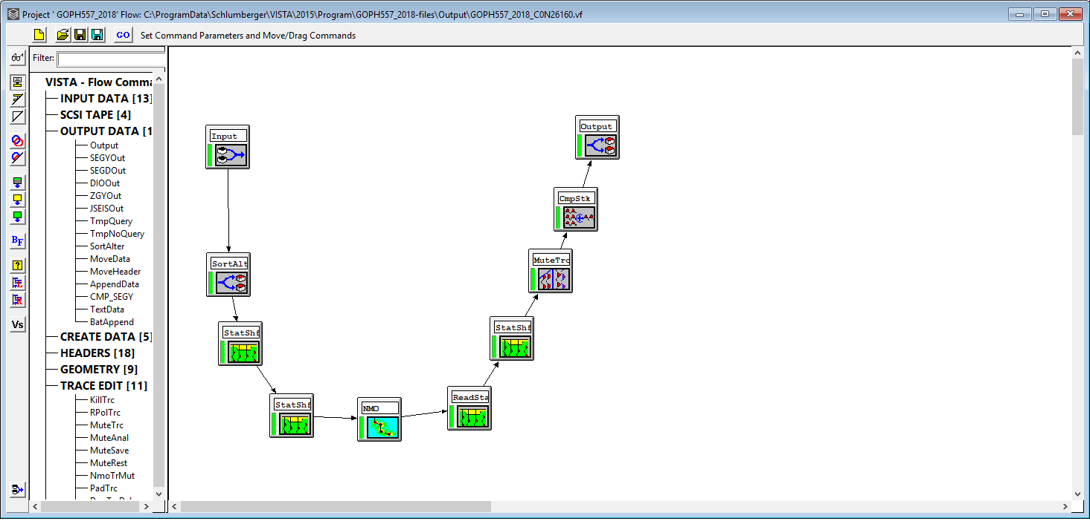
Part 5: Create and plot two stacks with mute

Slide 9
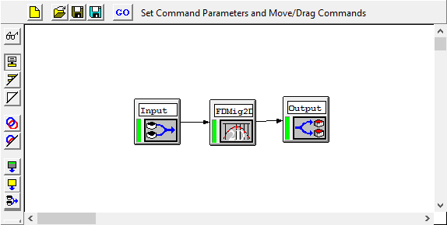
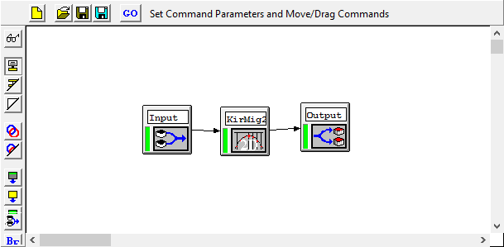
Part 6: Migrate data
Migrate with FD
Migrate with Kirchhoff

Slide 10
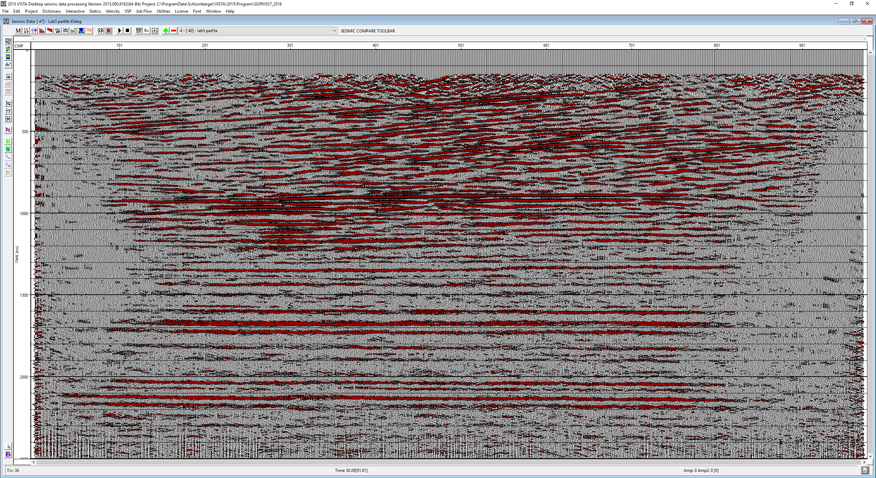
Brute stack

Slide 11
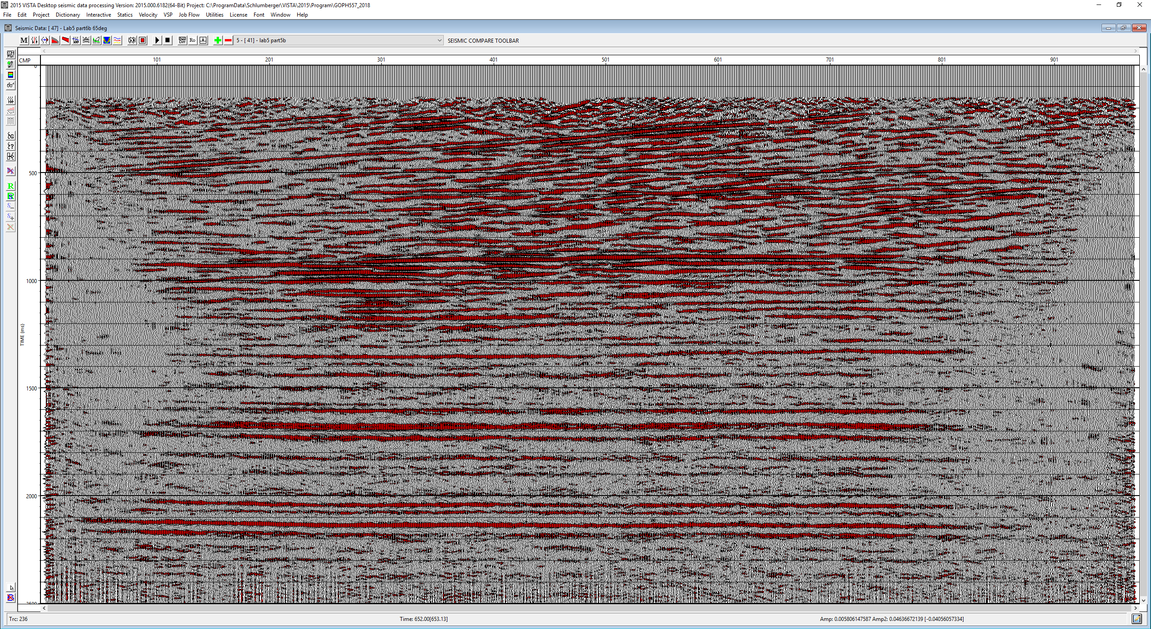
Best stack(with picked velocities and mute)

Slide 12
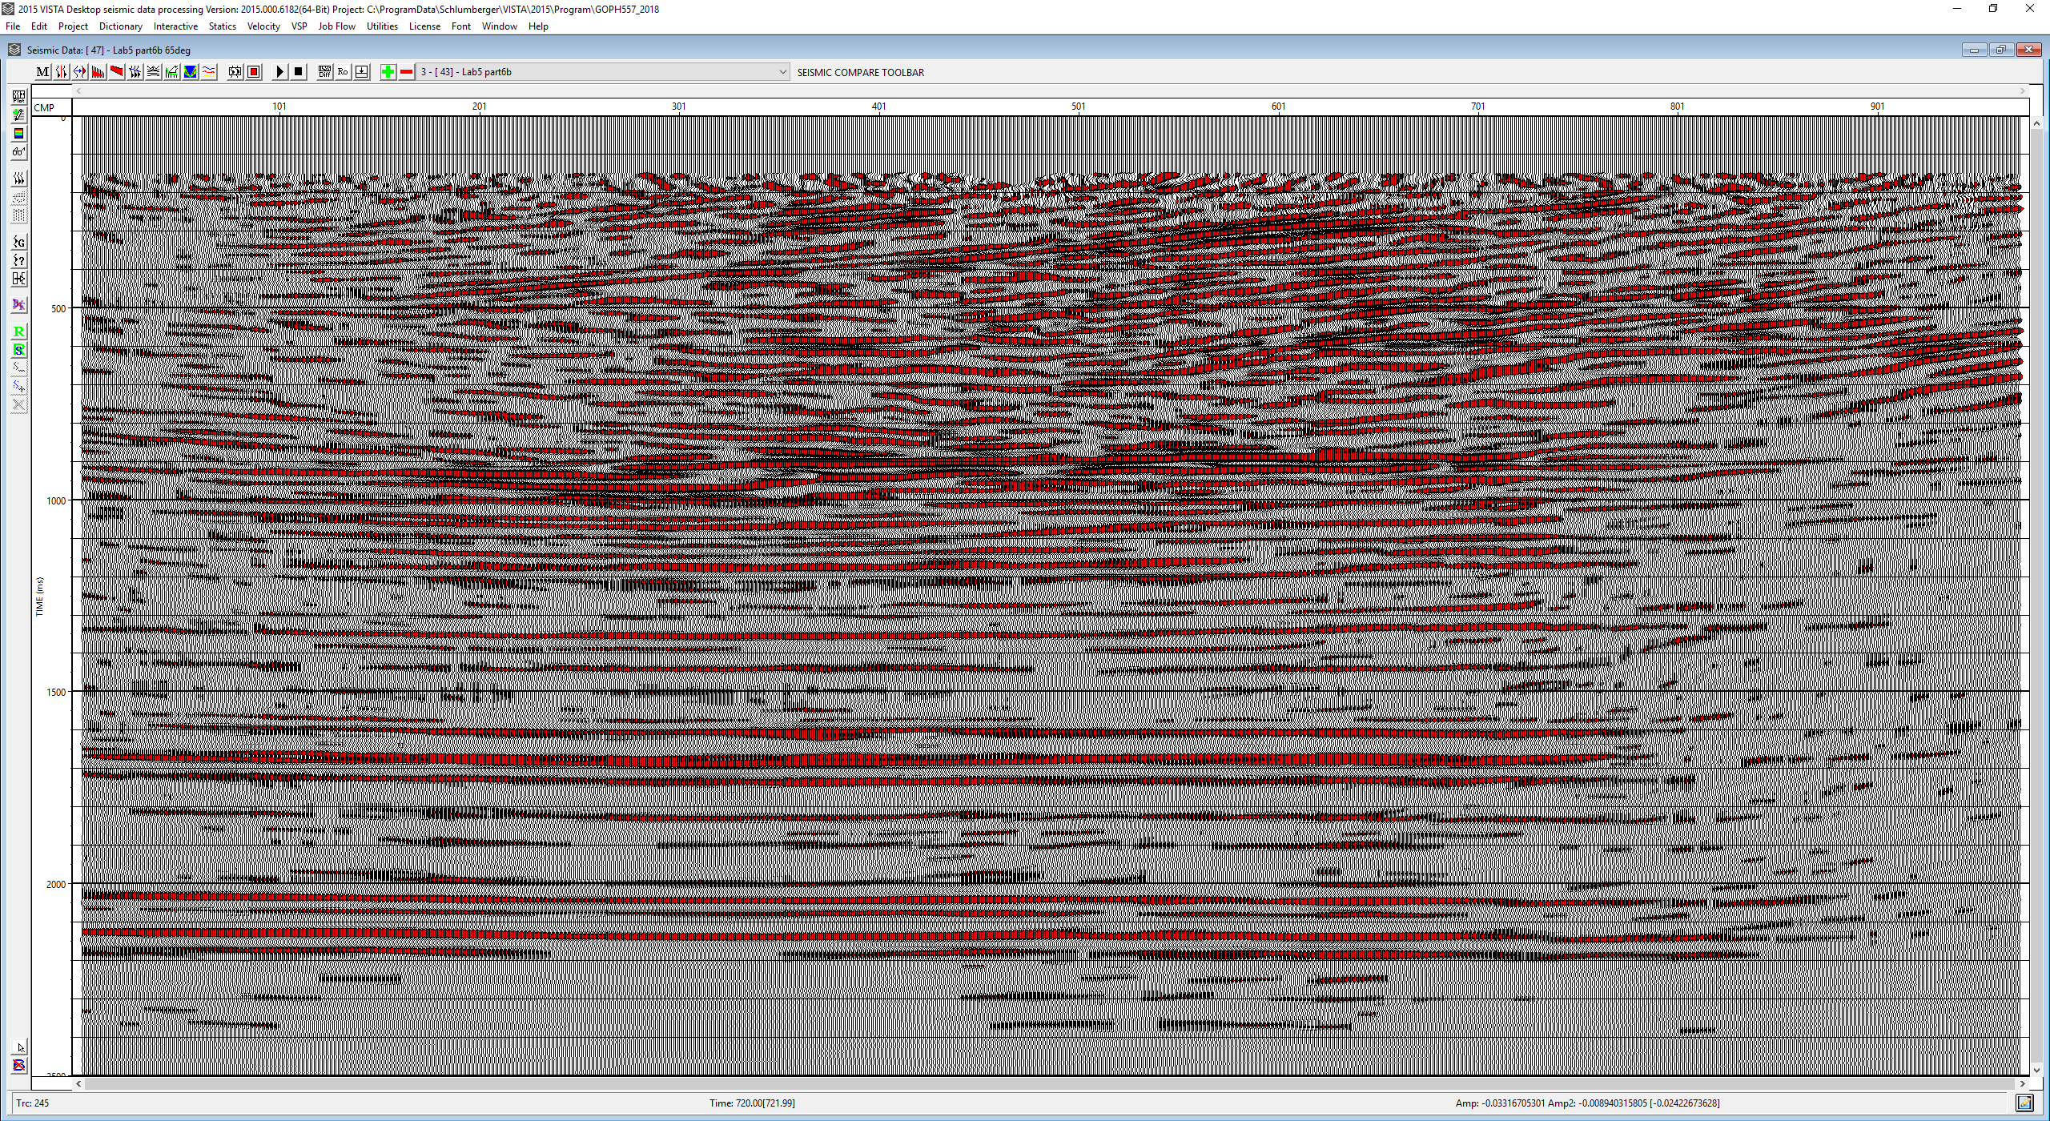
Finite Difference (15 degree)

Slide 13
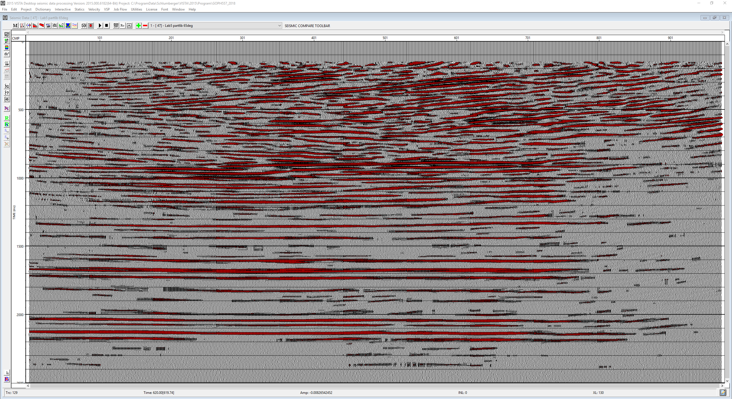
Finite Difference (65 degrees equation)

Slide 14
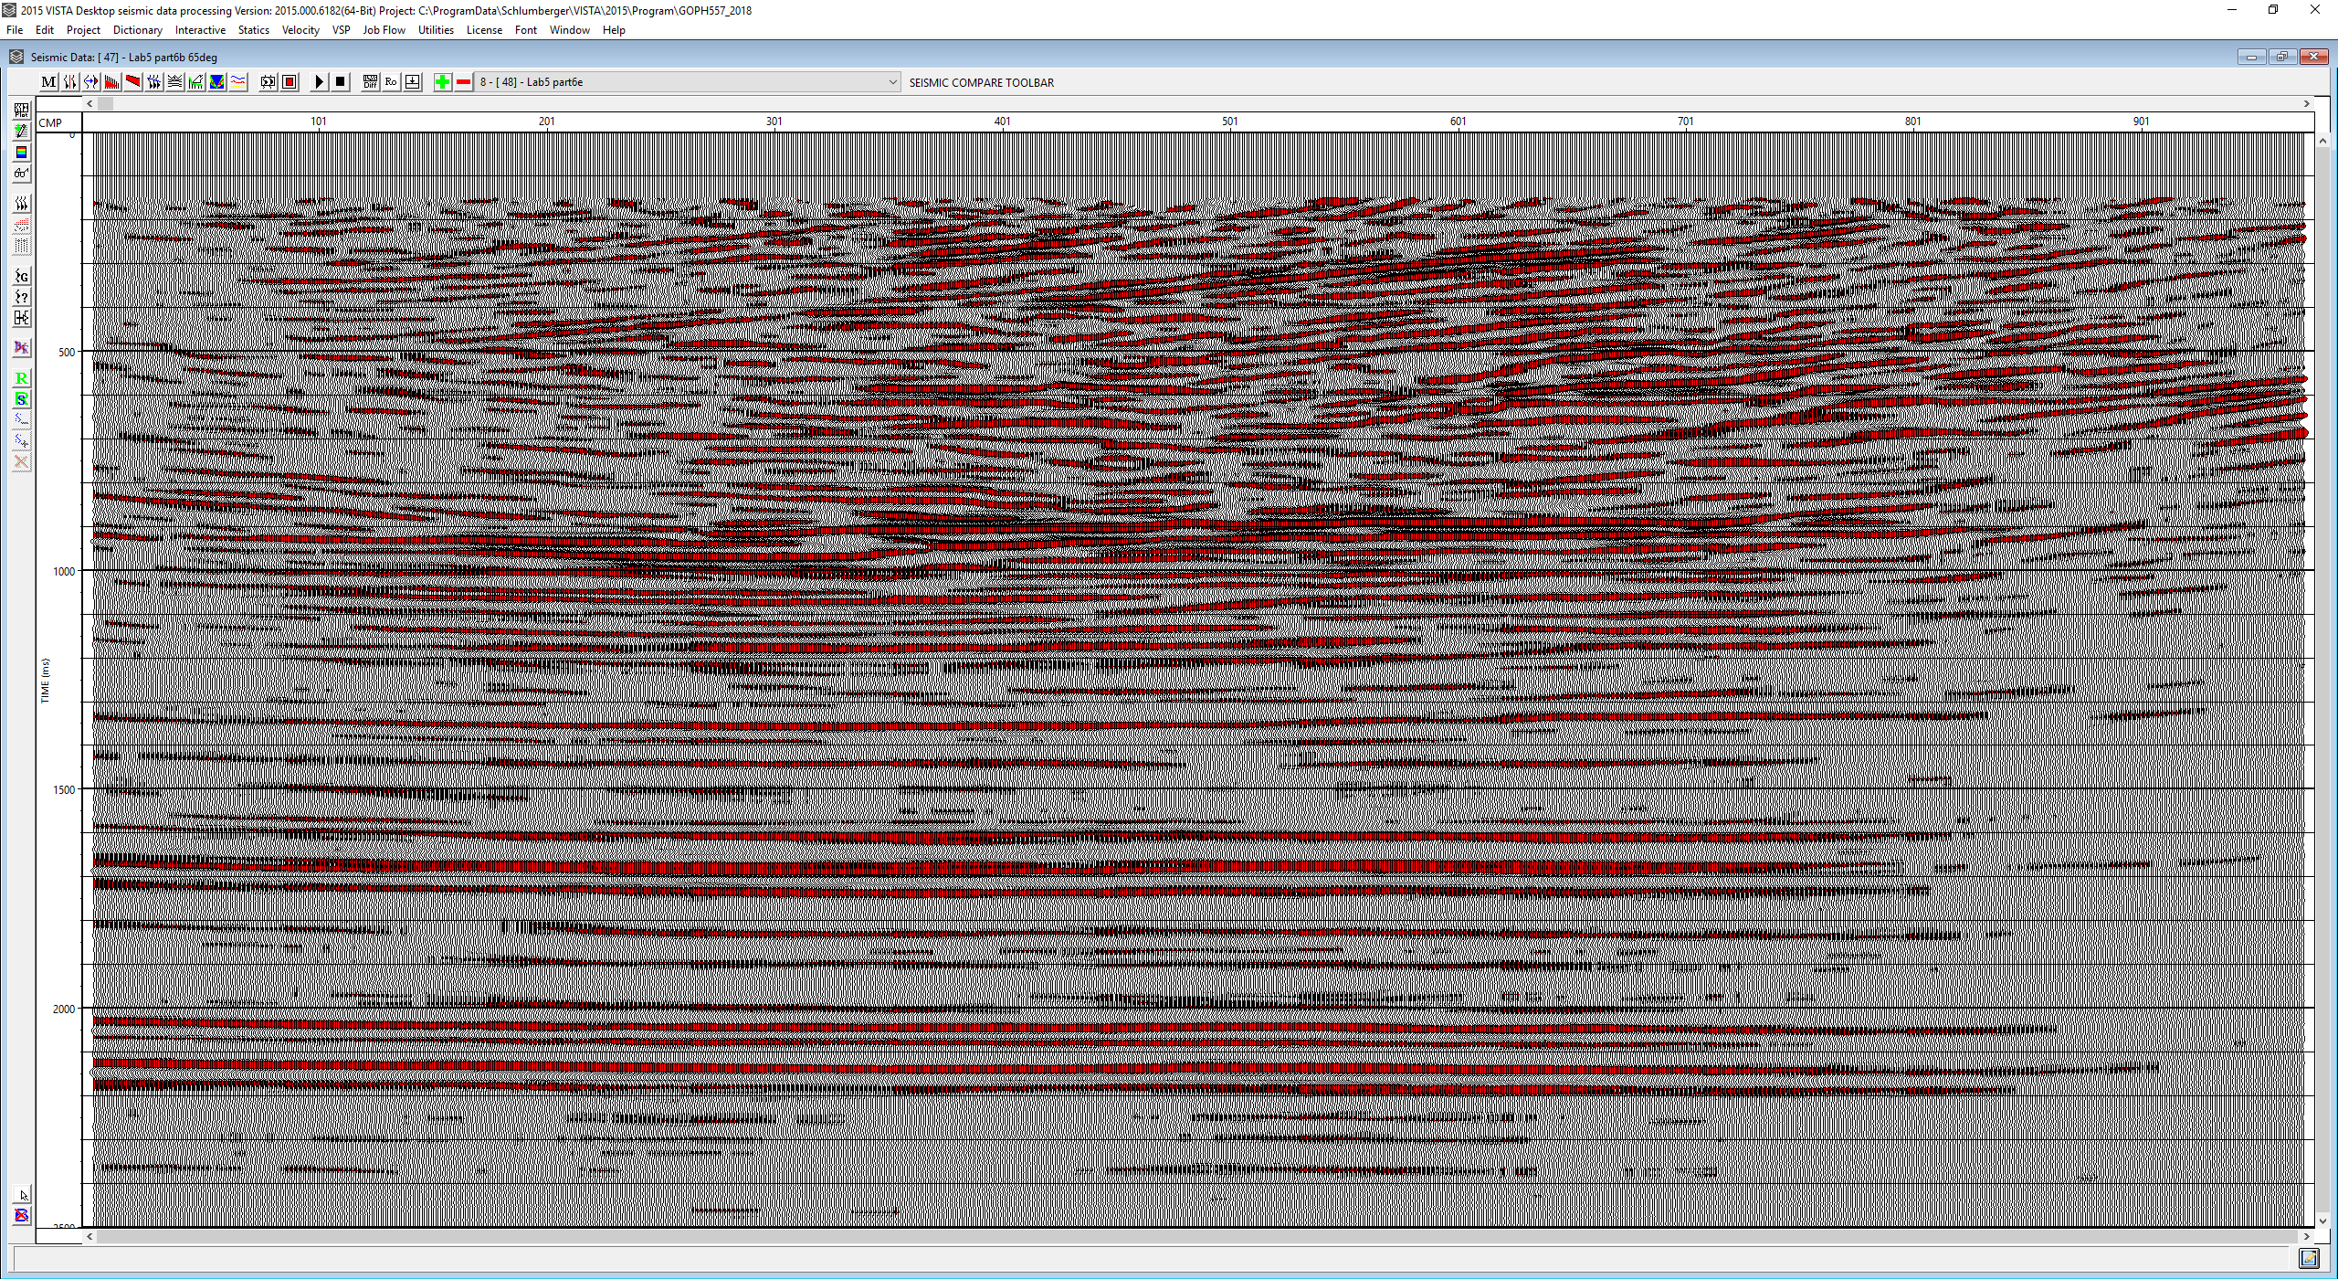
Kirchhoff (100% vel)

Slide 15
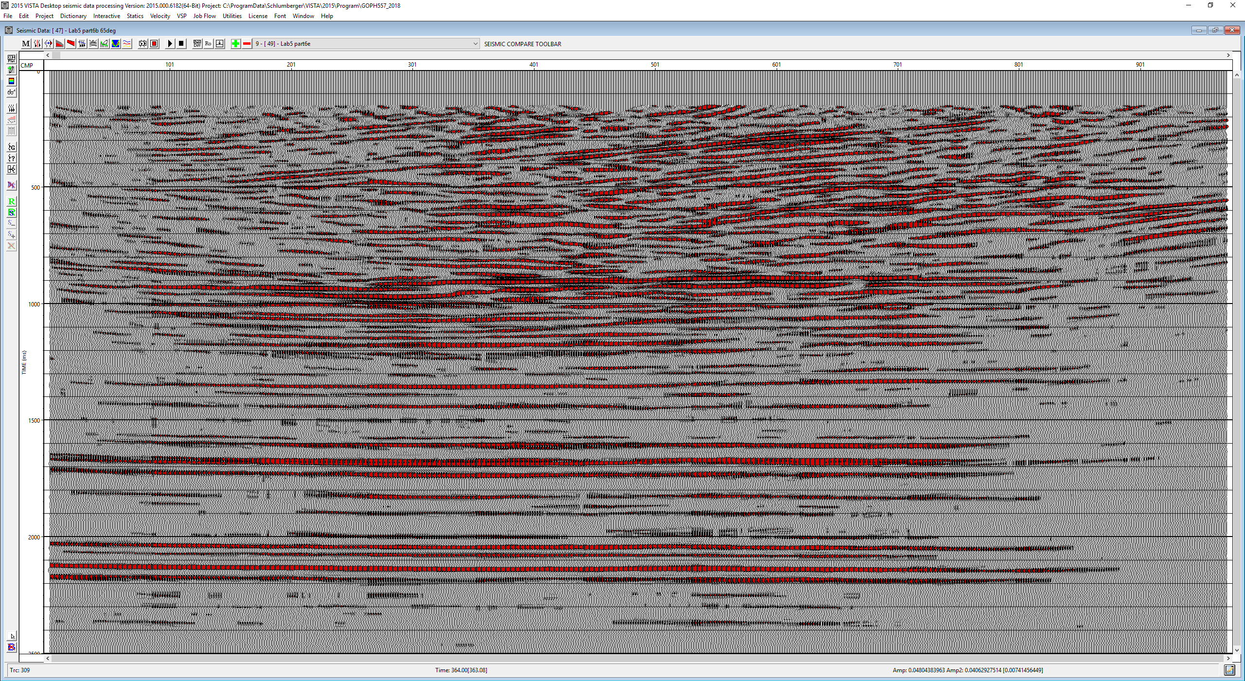
Kirchhoff (90% vel)

